Slide 1
Project phase Presentation:
For SSAM
Anna Zavjalova, Carl Cardone, Carl Stjernfeldt,
Freddy Tönnesson, HuaQing Yuan
Notes:
Freddy

Slide 2
Today’s
Agenda
Project Background
Our Study
Possibility of solution
Notes:
Freddy

Slide 3
Project Background
Carbon Footprint
NO.3
61%
77kg
If food waste were a nation
Food wasted per capita
Households account for a majority of the food wasted
Notes:
Feddy
‘Household food waste accounts for 61%, according to the statistics of the United Nations in 2021

Slide 4
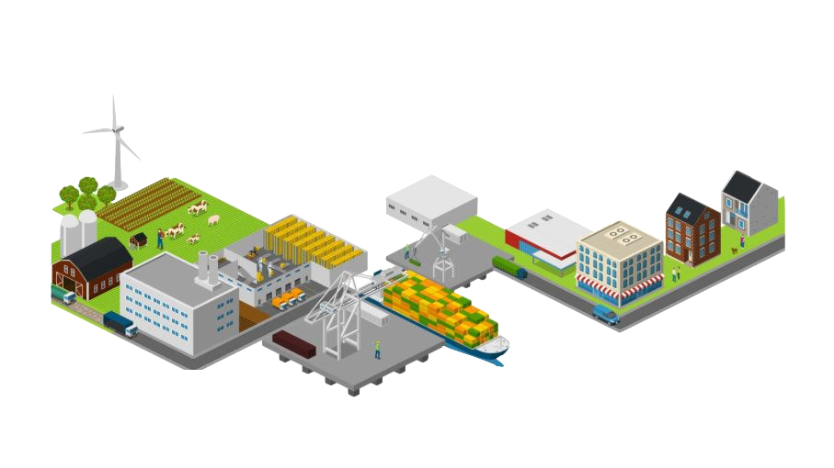
Project Background
Food is wasted differently from one country to another.
Average american household wastes about 31.9% of their food.
The English household wastes about 25% of all edible food
Defining food waste
Developing countries
farm
transportation
packaging
households
market
High income countries
manufacturing
distribution
Notes:
Freddy
but certain trends have been observed which suggest that food losses in developing countries happen in the agricultural stage. Retailers and consumers, however, tend to be the biggest contributors of food waste in middle- and high-income areas

Slide 5
Project Background
Survey conducted in the UK on 1892 participants + focus group.
Analysis of how/why households waste food (Höjgard et al, 2013).
Main reasons included:
-buying too much.
-poor storage management.
-poor planning.
-lifestyle factors.
-lack of skills.
-high sensitivity to food hygiene.
Notes:
Freddy

Slide 6
Project Background
According to several studies:
Households with older members tend to waste less food.
High income households tend to waste more food.
Large households waste less food than smaller households.
Notes:
Freddy

Slide 7
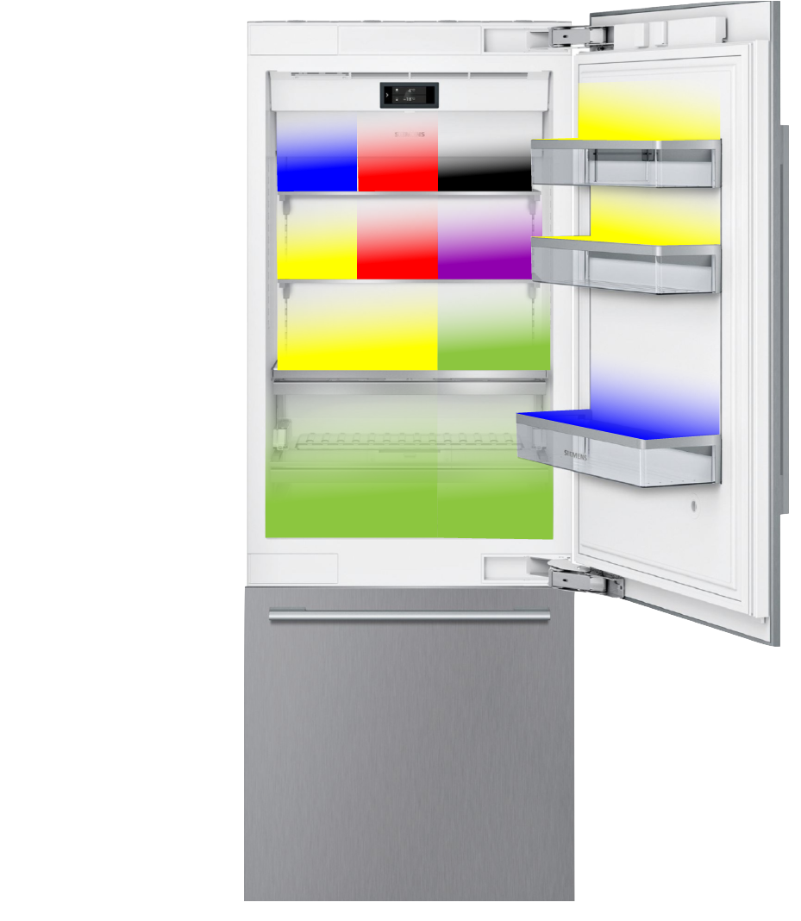
Methodology
--Australian study conducted by Farr Wharton et. al. (2012)
-How the organization of a fridge through color coding may reduce food waste within households.
-Increased awareness from household members on what is available in their refrigerator.
Pet food
Dairy
Drinks
Meat Products
Condiments
Produce
Leftovers
Notes:
Carl C
Study conducted by Farr Wharton et al on 7 Australian participants in 2012. Contacted the researchers to gain more insights on the specificity of the research and what they could have done better.

Slide 8
Our Study
--Recruitment Survey. Targeted sample
58% of the respondents have 2 adults in their household
92 respondents
24-82 years old
27% have 2 children in the household
Notes:
Carl

Slide 9
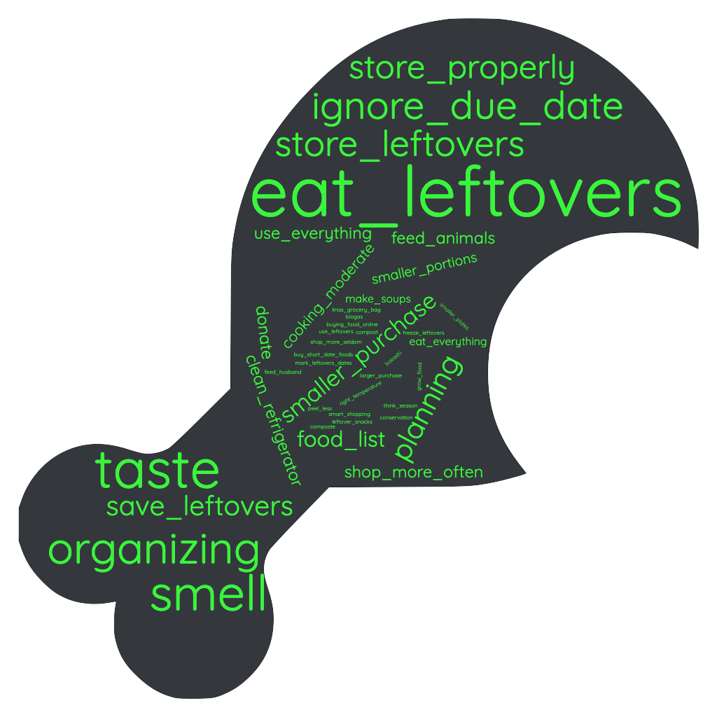
Our Study
--Recruitment Survey
--Can you give us three ways you can think of, to reduce food waste?
Picture
Less frequent suggestions include:
-Buying food online -Grow food
-Think season -Peel less
-Compost -Conservation
Notes:
Carl

Slide 10
Participants
--Interventional Study
44% of the households were 2 person households
27 households
14 in the test group
13 in the control group
72 participants
including children
37 in every group
Notes:
Freddy

Slide 11
Study results
--Interventional Study
Control group 107 kg
35 participants
Wasted around 3 kg per person
Test group 81 kg
37 participants
Wasted around 2 kg per person
The test group wasted 28% less food per person
Notes:
Carl

Slide 12
Study results
Mean food waste per person in the test group VS. control group (kg)
3.5
3
2.5
2
1.5
1
0.5
0
Test Group
Control Group
Notes:
Carl

Slide 13
Possibility of solution
Notes:
Freddy

Slide 14
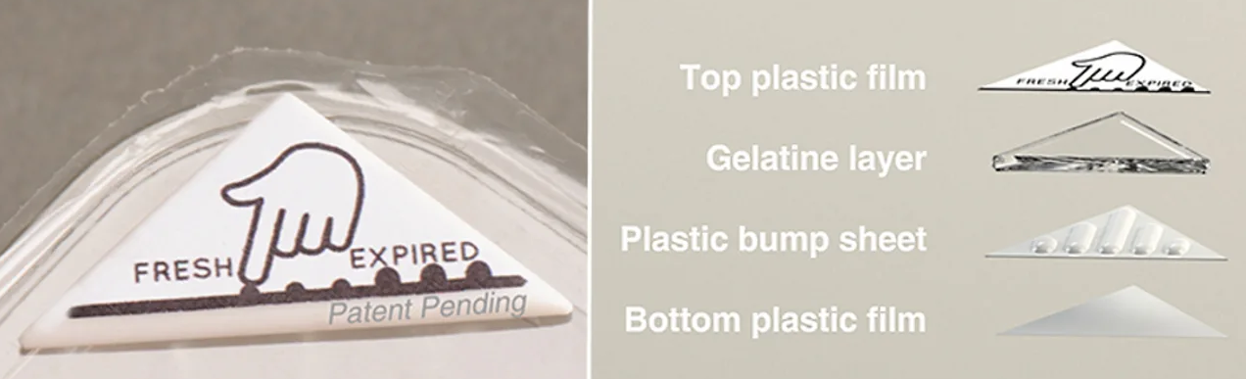
Potential solutions
Packaging and containers
-Different packaging technologies: multilayer barrier packaging, Modified atmosphere packaging, edible coatings.et.
-Bio-reactive food expiry label—Bump Mark
Intelligent fridges
and Apps
-Smart refrigerator--ZmartFri
-Color Coding the fridge
-FridgeCam
-Changing Plate size
Notes:
Freddy

Slide 15
Thanks for listening！
Notes:
Freddy

Slide 16
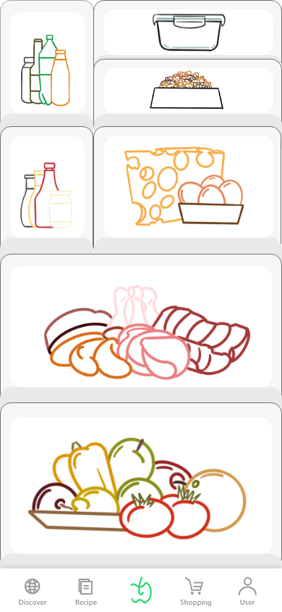
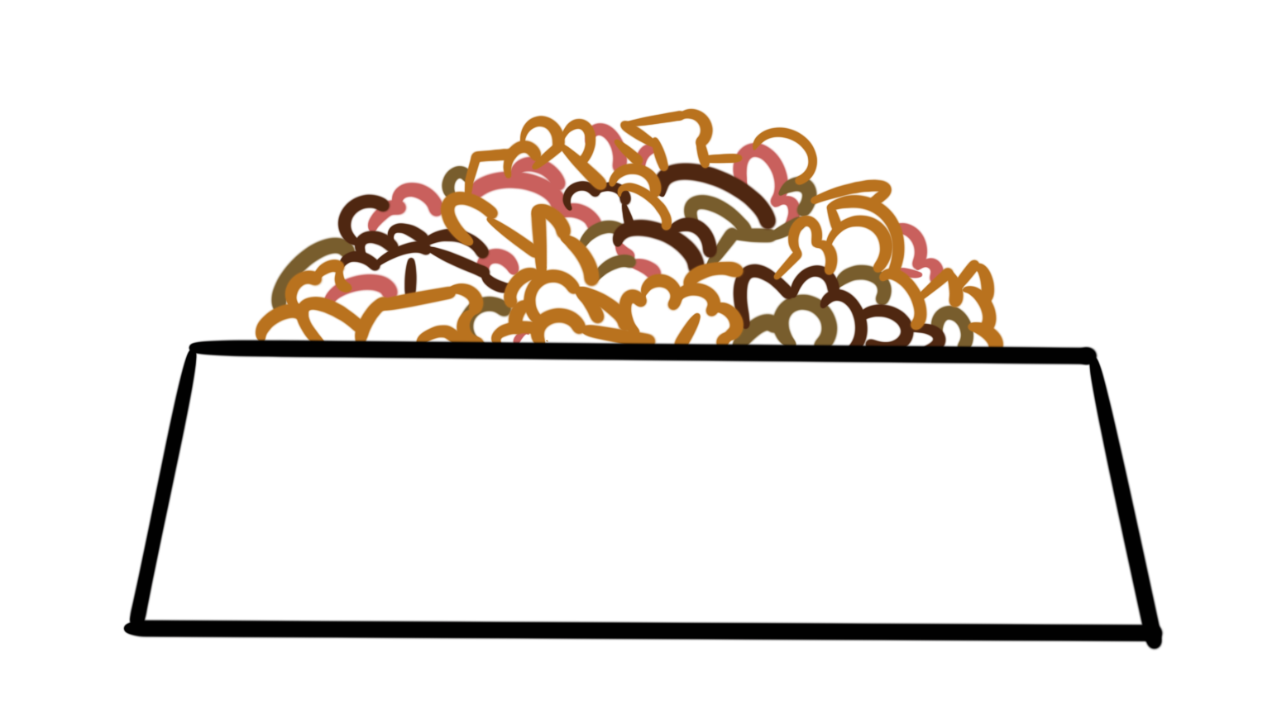
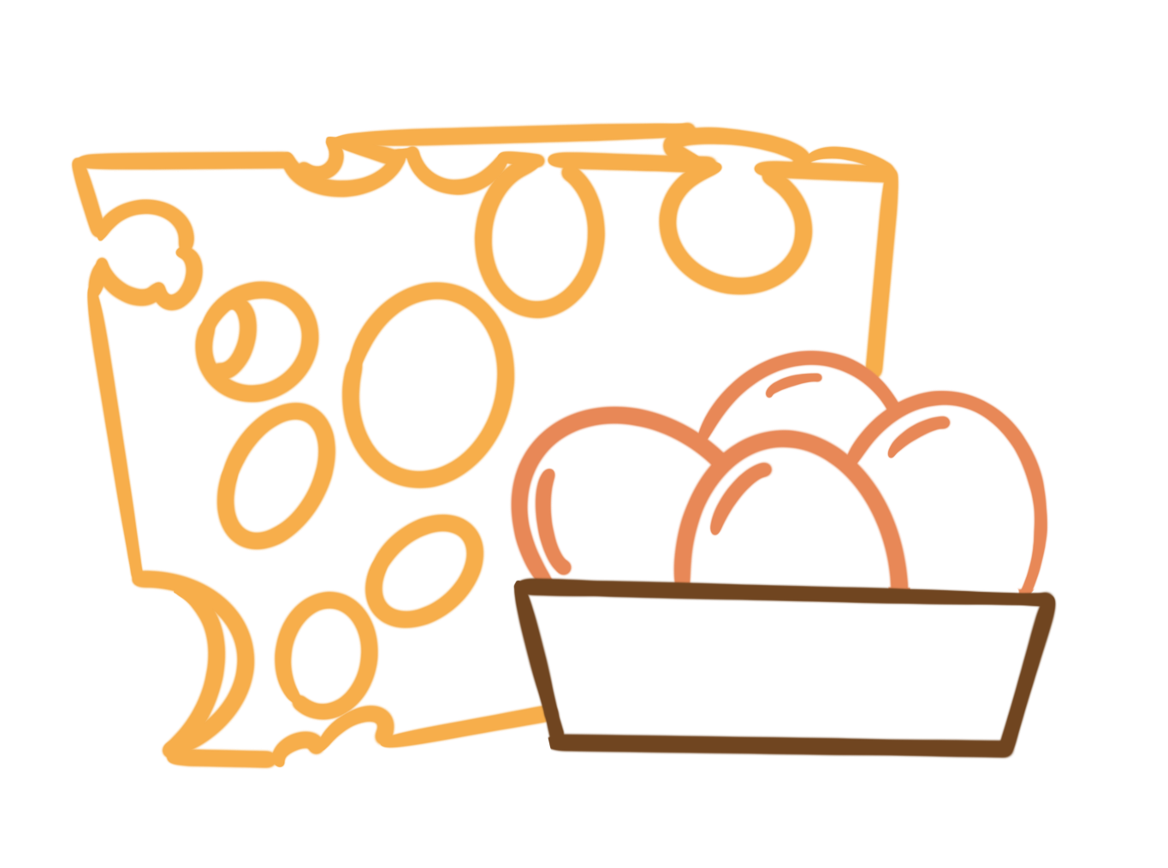
According to the color coding of the refrigerator, we divide the food into seven categories
Drinks
Leftovers
Condiments
Pet food
Meat Products
Dairy
Produce

Slide 17
